Slide 1

Level Up! Gym
Business Plan
Presented by
Chelsea Ferguson and Christopher Sigouin

Slide 2
Company Description
A video game exergaming facility dedicated to provide unique fitness experiences and lots of fun!
Core Values
Fun. Fitness. Motivation. Leadership. Health. Well-being

Slide 3
Who we cater towards
Video game enthusiasts
Fitness fanatics
Members new to fitness
Modern Adults / Elderly

Slide 4
Video example of exergaming!

Slide 5
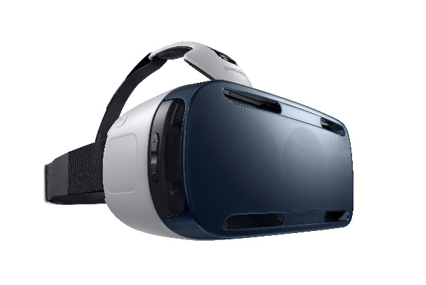




Products & Services

Slide 6
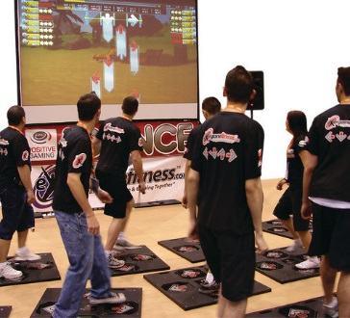
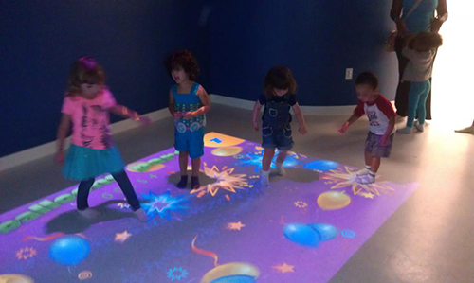
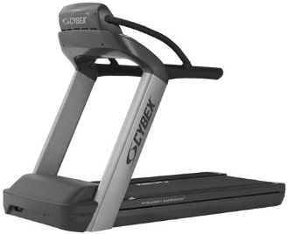
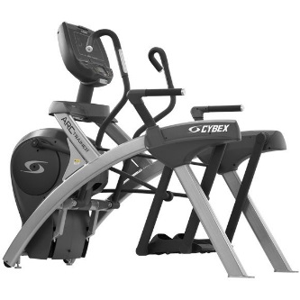
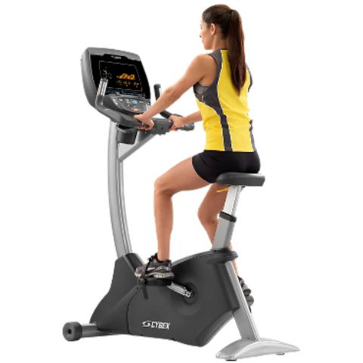
Products & Services

Slide 7





Products & Services

Slide 8
Products & Services
Gym Profile App
Fitness Classes
Memberships
Kid’s Zone
Game Zone

Slide 9
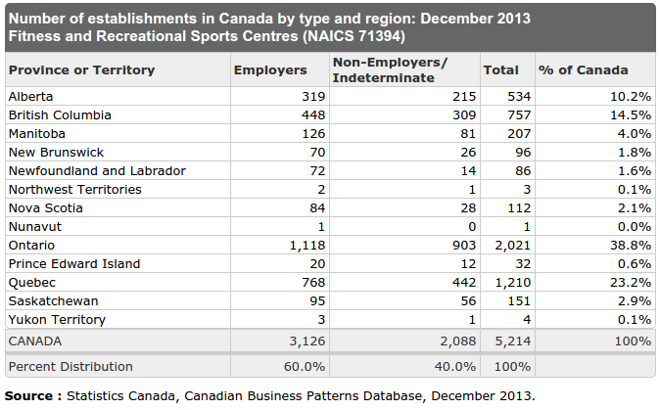
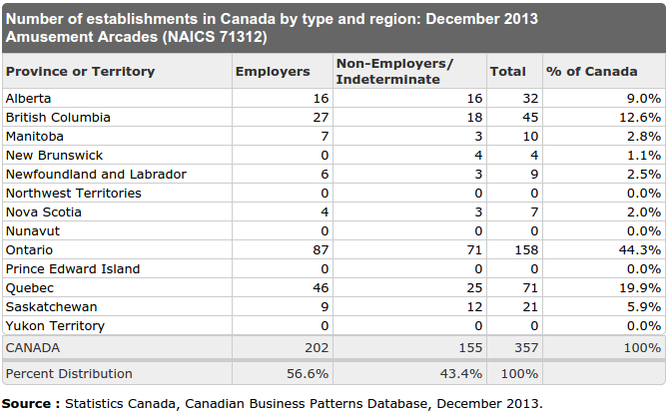
Marketing
Industry Analysis

Slide 10
Marketing
Our 4 P’s
Product
Price
Place
Promotion

Slide 11
Marketing
Legal
Fitness / Health Club Insurance
Exergaming Software ( Wii-U & Xbox One )
Gym Profile Software

Slide 12


Slide 13
Management Plan
Chelsea Ferguson
[Chief Executive Officer]
Christopher Sigouin
[Chief Operating Officer]
Fitness Professionals
Cleaning Staff
Michael Gergely
[Chief Financial Officer]

Slide 14
Management Plan
Personnel
General and Personal Fitness Trainers
Daily Sanitization & Hygienic Practices
Terms and Conditions for Memberships

Slide 15
Organizational Plan
Stage of Development
Current Operational Development Status
and Requirements
Industry Association Memberships
Suppliers

Slide 16
Organizational Plan
Production Process
Day-To-Day Operations
General Rules and Regulations
Facility Hours, Duties and Operations
Feasibility ( Product & Prototype testing )
Physical Location

Slide 17
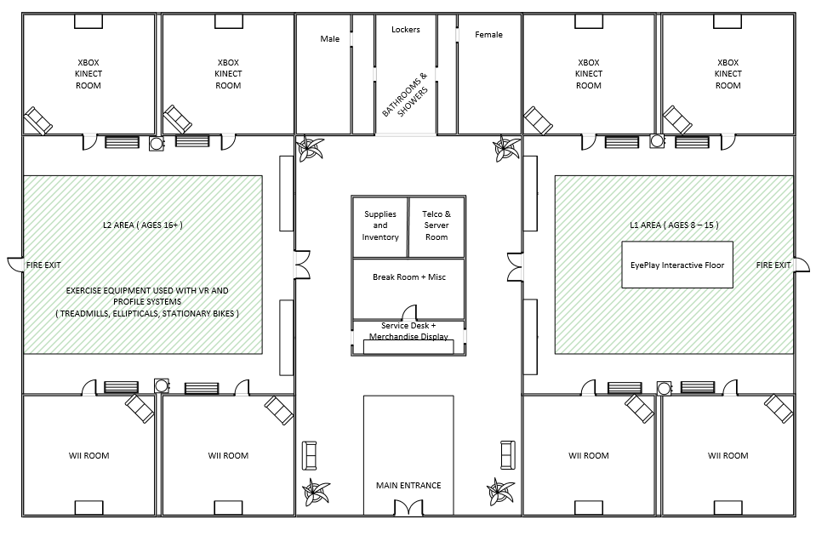

Slide 18
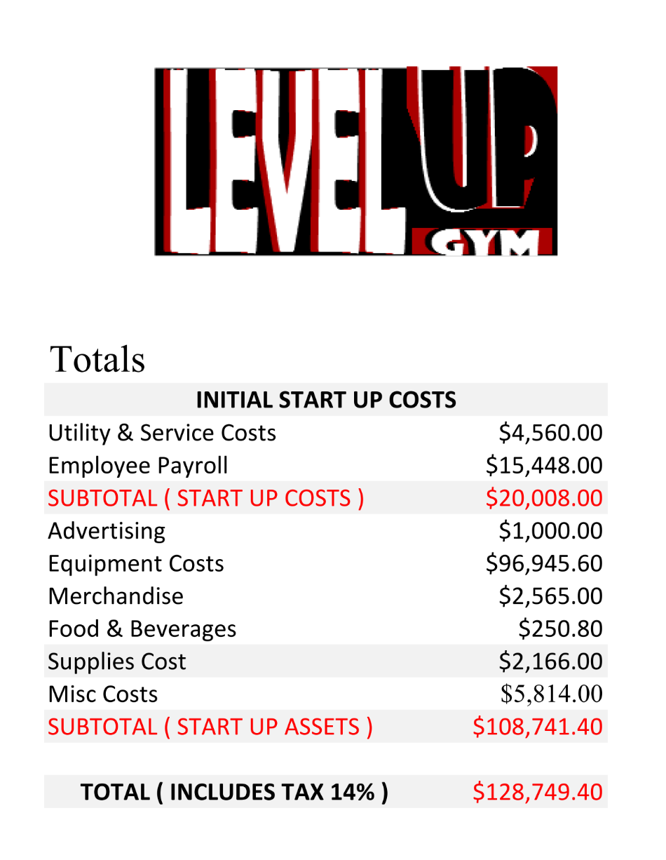
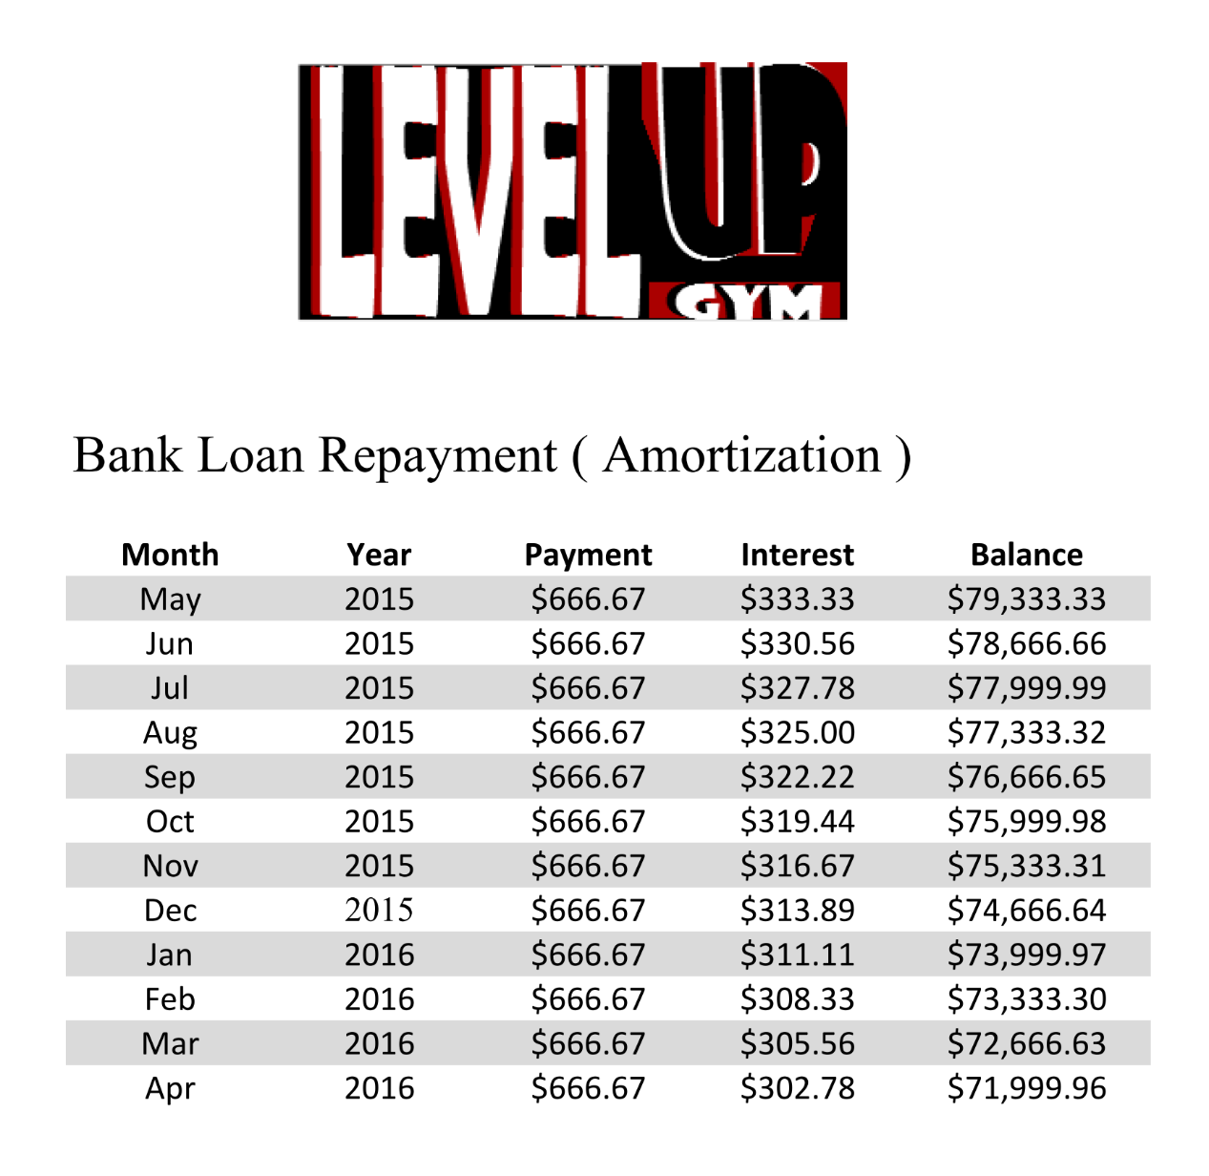
Financial Plan

Slide 19
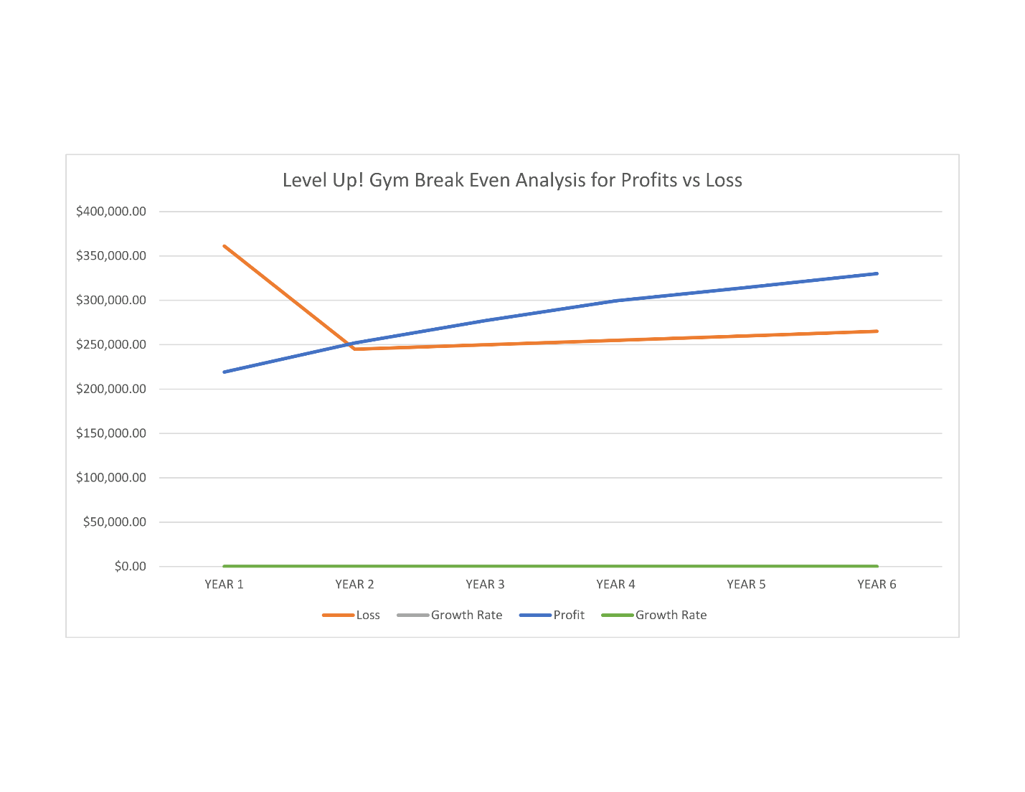
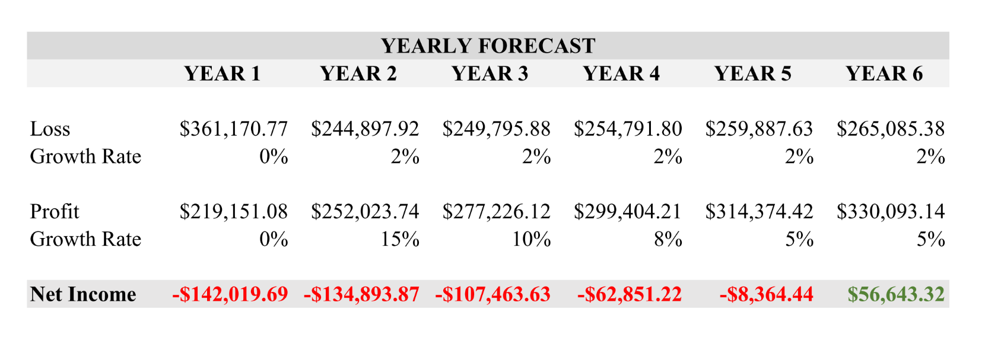
Financial Plan

Slide 20
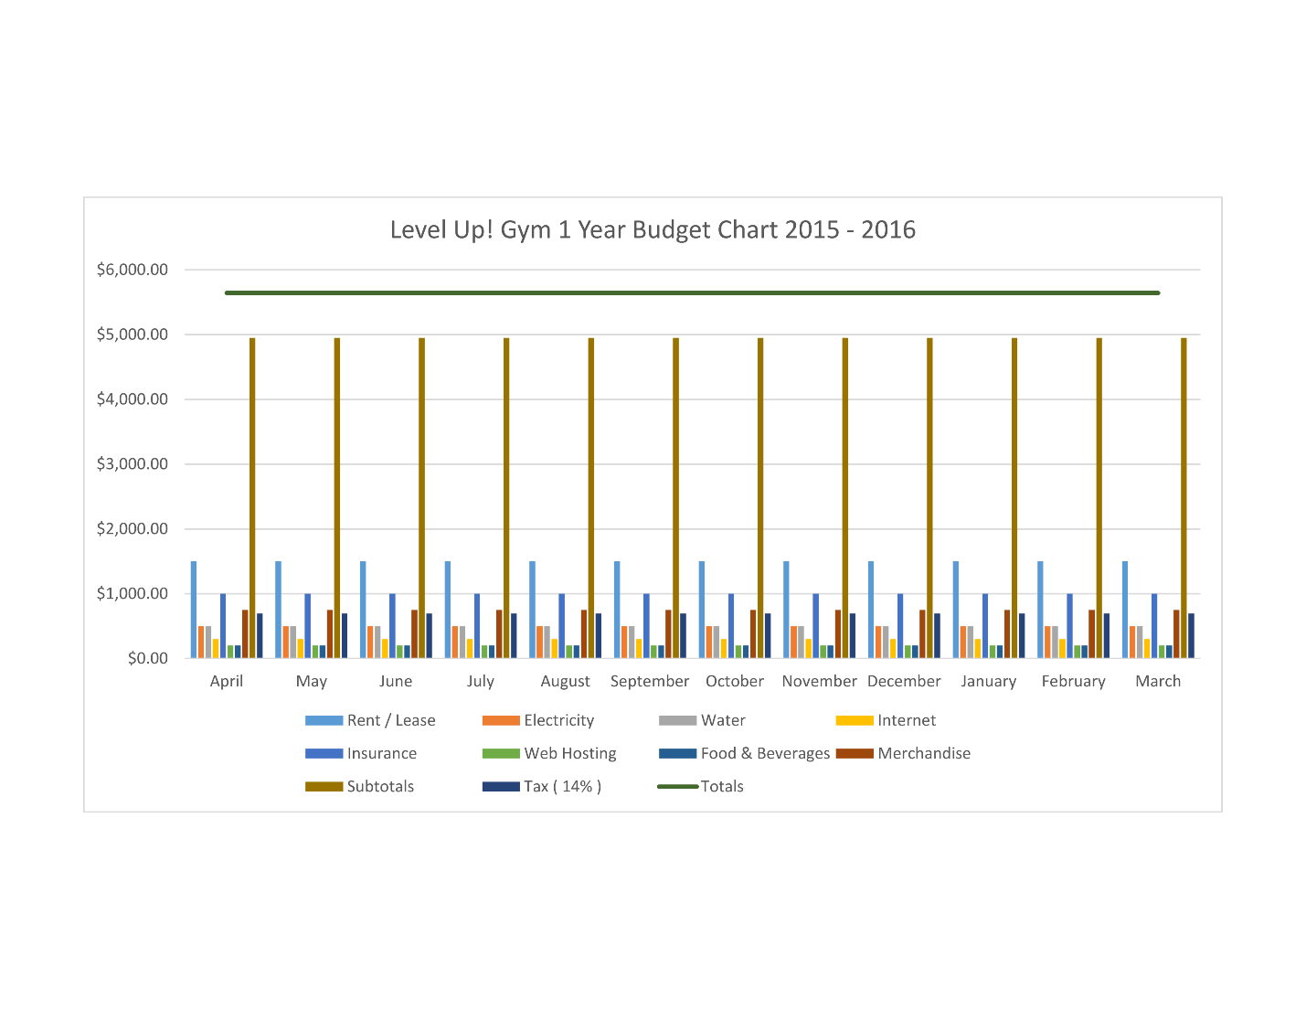
Financial Plan

Slide 21


Exergaming is the future
Social Action Project ?
Summary of the Presentation

Slide 22
Intro
Types of Gym Goers – Kind of like different classes of gym goers
What makes Level Up! Innovative ( products / services )
---------- other information ------------
Marketing
Operational
Financial
Outro

